Slide 1
How to use PHP with a MySQL Database
Delete
Search

Slide 2
Deleting Data
DELETE command is used to remove rows from a table. DELETE FROM contacts WHERE id = ‘9’;
If you don’t specify a where clause, all rows will be deleted from the table.
Could use a LIMIT clause to limit how many records are deleted.
DELETE FROM contacts LIMIT 1;

Slide 3
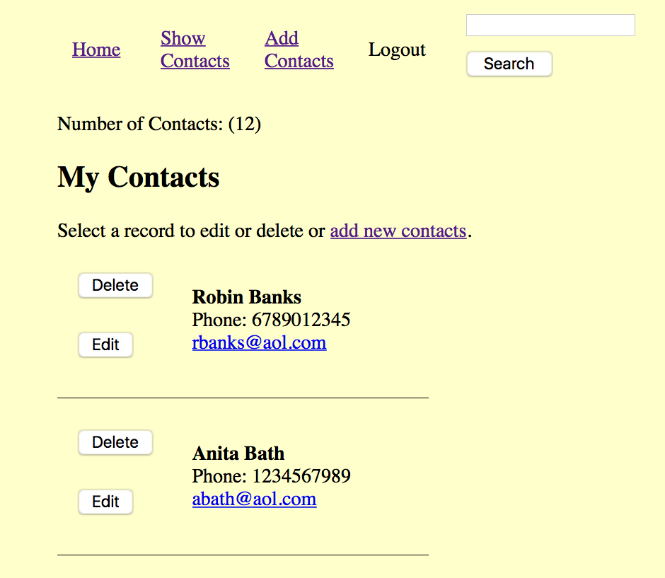
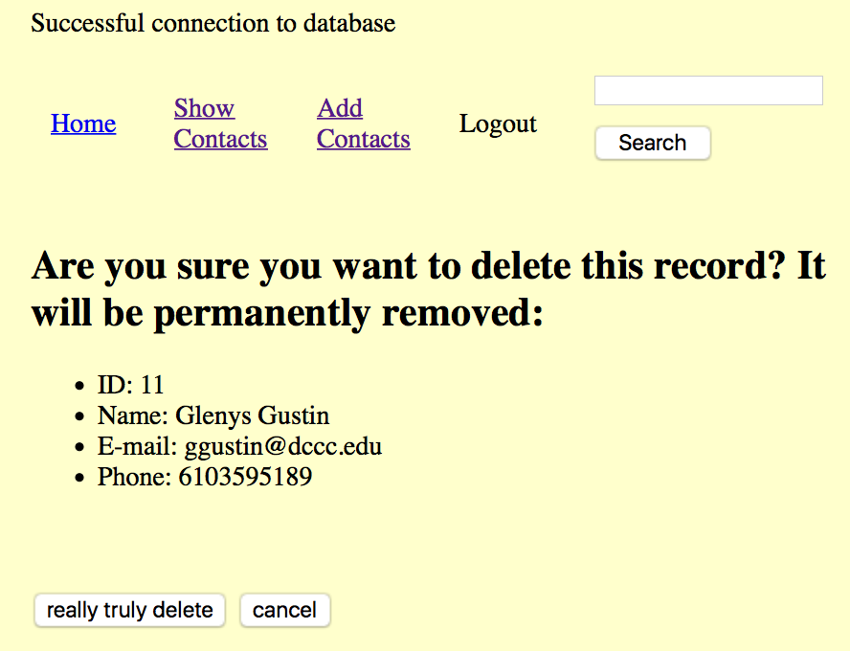
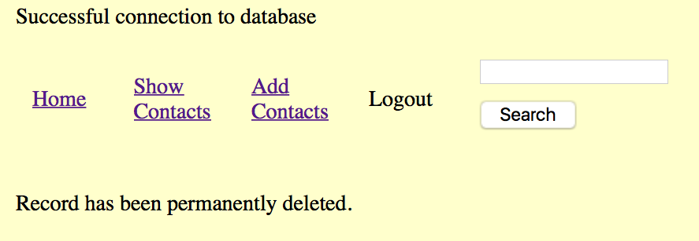

Slide 4
Good Form
Use a primary key to find exact matches.
Show user information that is about to be deleted to allow them a second chance to change their mind.
Confirm the record has been deleted.

Slide 5
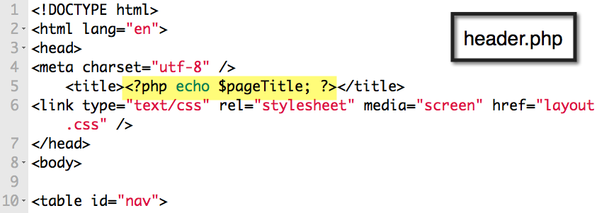
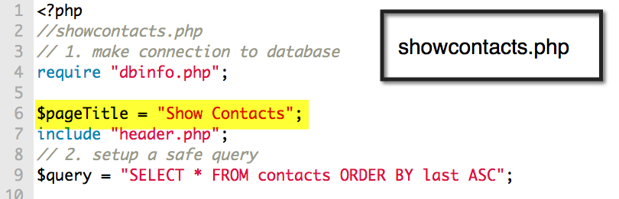

Slide 6
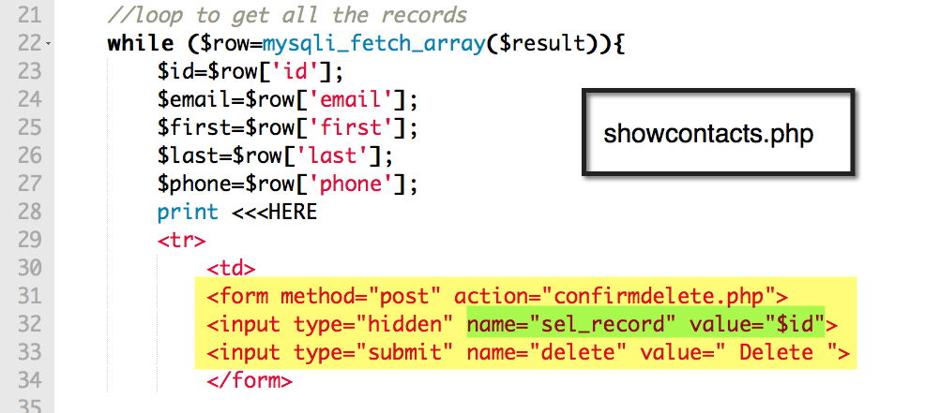

Slide 7
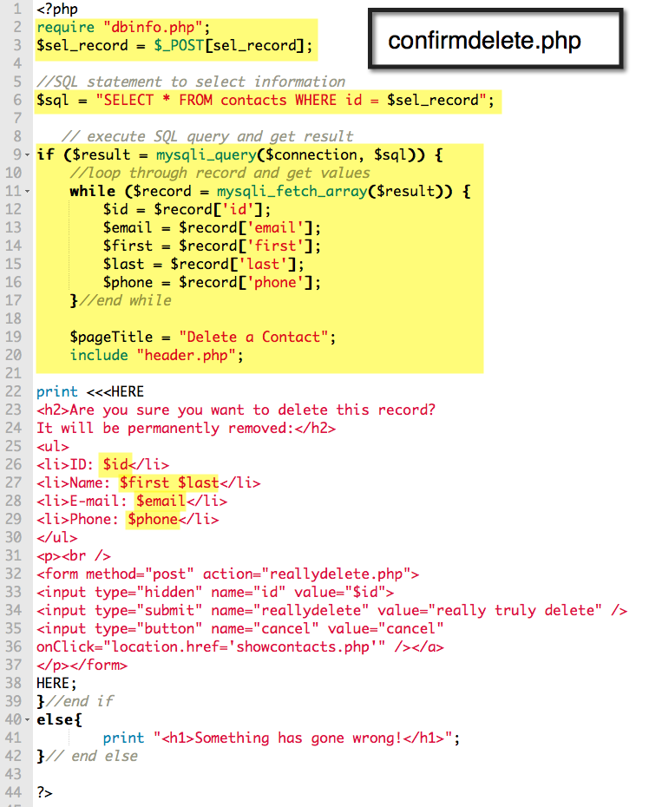

Slide 8
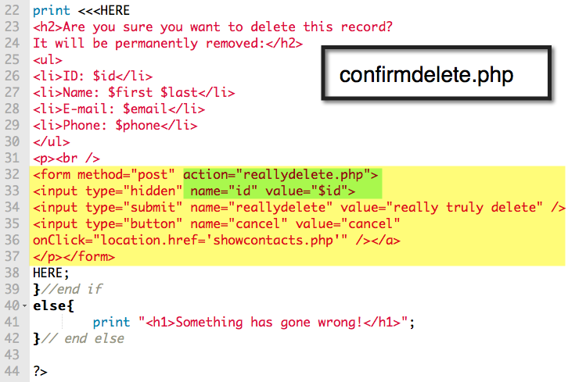

Slide 9
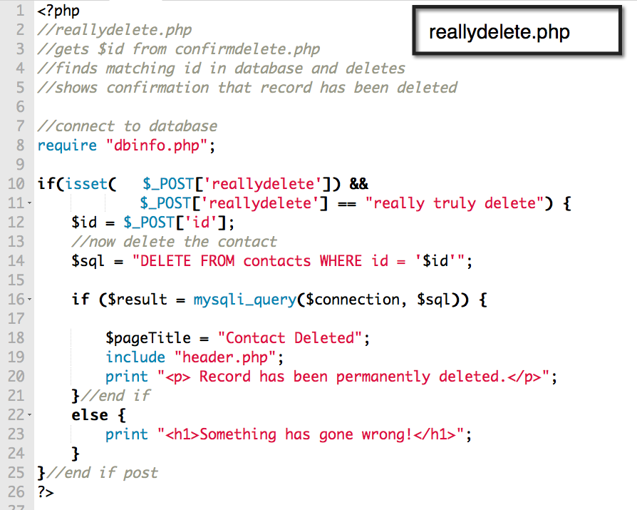

Slide 10
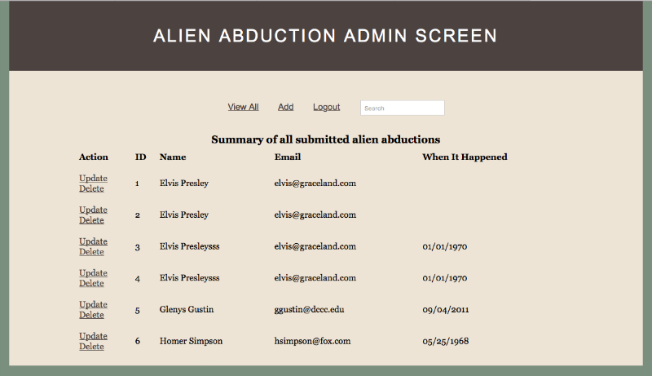
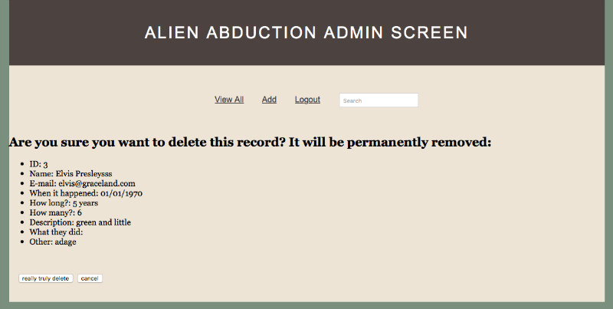

Slide 11
SCRUD Lab
Search
Create
Read
Update
Delete
See if you can connect to your Aliens Database and delete a record in your table.
This is the Delete component of the lab.

Slide 12
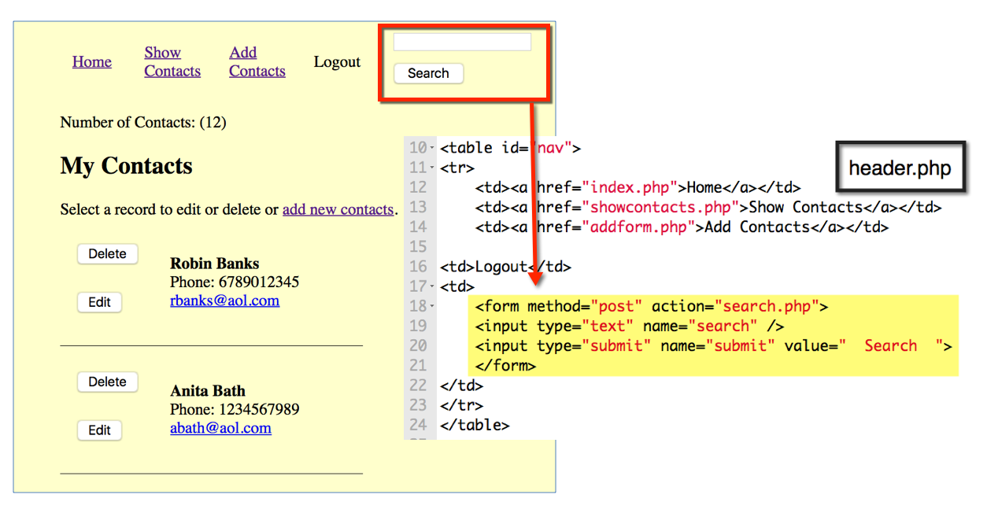
Searching

Slide 13
Using the SQL LIKE Operator
Powerful technique to find info in a db.
Combined with wildcards to specify the string pattern (or mask) to match.
% indicates any characters

Slide 14
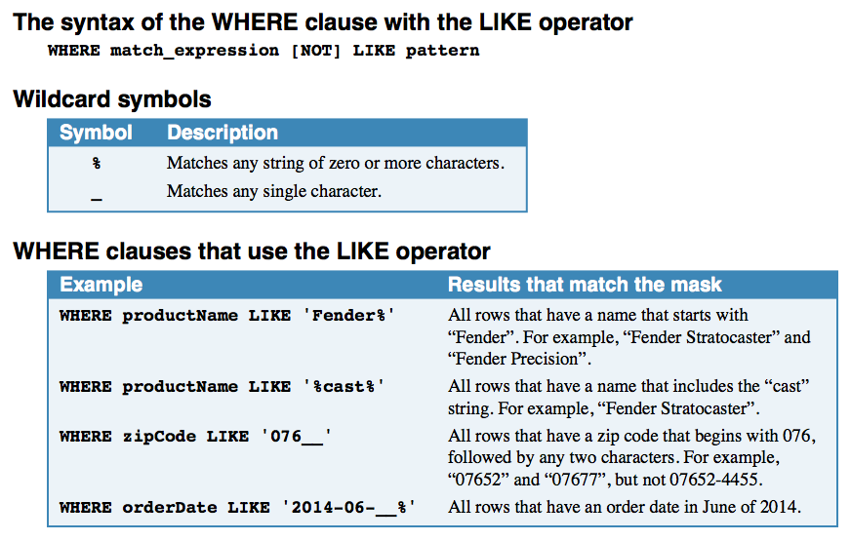

Slide 15
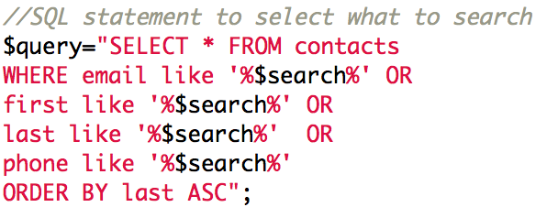

Slide 16
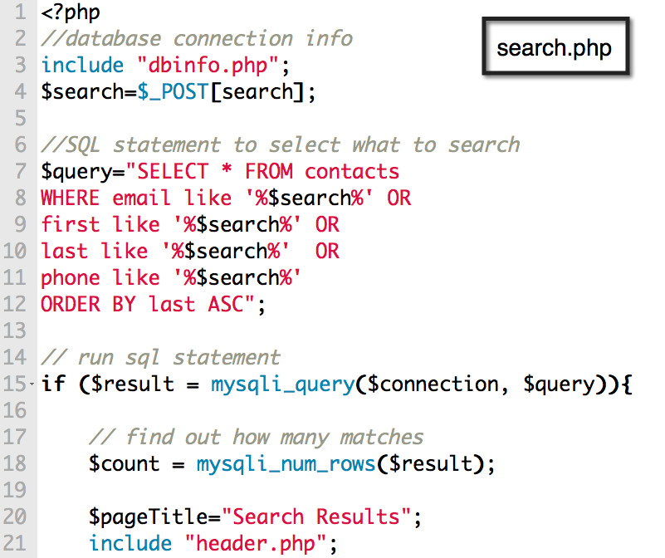

Slide 17
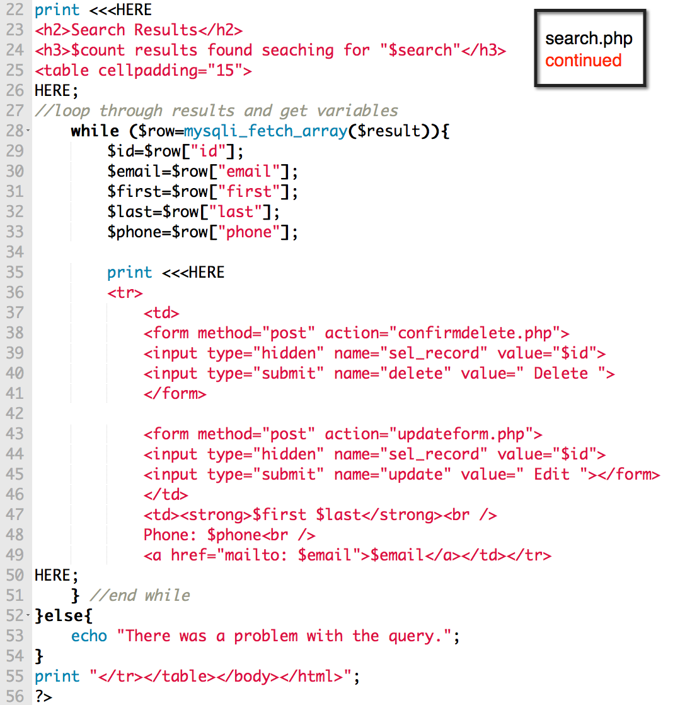

Slide 18
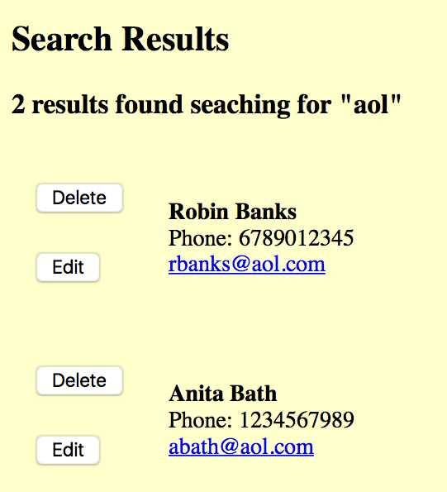
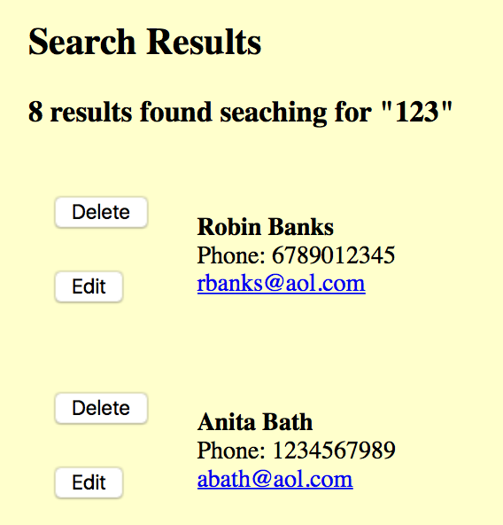

Slide 19
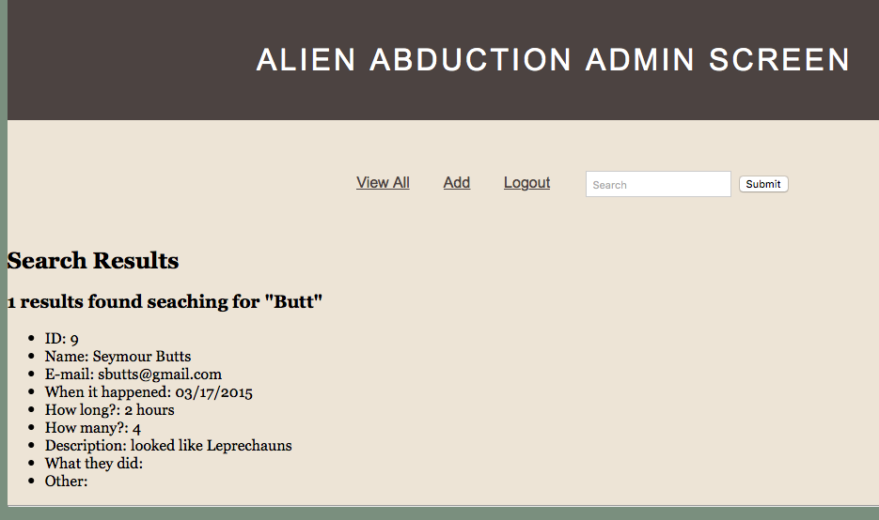

Slide 20
SCRUD Lab
Search
Create
Read
Update
Delete
See if you can connect to your Aliens Database and Search for records that match a pattern in your table.
This is the Search component of the lab.

